Slide 1
The Attitudes of Leadership

Slide 2
Agenda
Praise and worship
Welcome & Prayer
Discussion Questions Review
Teaching – Attitudes of Leadership Session I
Break
Teaching – Attitudes of Leadership Session II
What is a Growth Group?
Questions and Answers
Action List
Distribute Materials
Close with prayer.

Slide 3
Practices of
Leadership – Review
The Problem of Competing Systems
The Need of a Common Language
7 Practices of Effective Ministry
Clarify the Win
Think Steps, not Programs
Narrow the Focus
Teach Less for More
Listen to Outsiders
Replace Yourself
Work On It

Slide 4
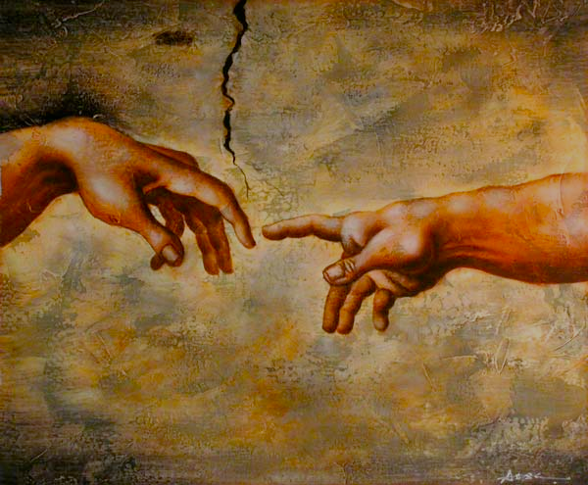
Foundational Attributes
Pursuit of God
Matt. 5:6, “Blessed are those who hunger and thirst…”
Psalms 42:1-2, “As a deer pants for flowing streams…”
Psalms 63:1-2, “…earnestly I seek you; my soul thirsts for you…”
Can I get a volunteer to briefly share a time they heard from God?
A leader must be irrevocably committed to seek and to find, to hunger and thirst after God Himself!
Notes:
Pursuit of God has to be done with passion, zeal and true thirst to know him. How is it that we are to pursue God and wait on God at the same time?
Waiting on God is a pursuit. Resting in him is a pursuit. The passion and zeal are needed to put off all the other things that compete for our time.
Because we want to pursue him, because we want to know him, we make our time with him our first priority and we let nothing get in the way of that time. Then, during that time, we pursue him by waiting.
Integrity - Oneness, Singleness of heart, heart after God.
What is God doing in your life? be comfortable talking about our relationship with God. Be deep with God, not shallow.

Slide 5
Foundational Attributes
A Life lived in hot pursuit of God ...
A life lived with little pursuit of God ...
Notes:
Grapes and Raisins
Spiritual life with no pursuit - You may have some success but you're left looking and feeling like a raisin - dried up
Spiritual life of pursuit - You have success out of the overflow - when squeezed, the sweetness of God comes out just like when a Grape is squeezed

Slide 6
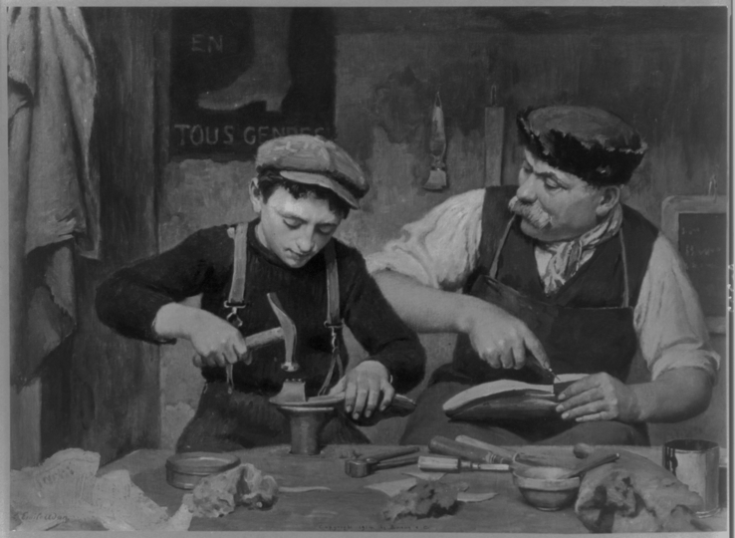
Foundational Attributes
Learners Attitude
Proverbs 1:5, “Let the wise hear and increase in learning.”
Proverbs 1:7, “The fear of the Lord is the beginning of knowledge”
Proverbs 2:3-5: “...if you CALL OUT for insight and CRY ALOUD for understanding, and if you look for it as for SILVER and search for it as for HIDDEN TREASURE then you will understand the fear of the LORD and find the knowledge of God.”
Luke 2: 46 “After three days they found him in the temple, sitting among the teachers, listening to them and asking them questions.” -- JESUS WAS A LEARNER!
A leader must possess a desire to learn and to grow in every area of life. He must be open to learn from both God and man!
Notes:
Leaders are learners and learners are leaders.
A good leader spends much time listening, understanding, waiting on wisdom.
A rash, uncontrolled, impatient leader goes with the gut reaction and does not seek to learn or understand the situation.
See every situation as a chance for God to teach you something. Rest in that.
Do I ask Questions? What kind of Questions do I ask? Do I genuinely try to seek wisdom and insight.
Prov 1:25; Prov 3:13; Prov 4:7
Be a magnet to wisdom
A man’s openness to learn from others is a barometer to his ability to learn from God.
People follow you because of God’s anointing not because we are smart.
---------
You can learn from anyone. You should learn from everyone
Much of my BEST LEARNING COMES From SISTER SANDPAPER ... Many times there is a nugget of truth in criticism delivered in the wrong way.
Also, Remember Iron Sharpens Iron - Prov 27:17 Iron sharpens iron, and one man sharpens another -- SPARKS FLY when IRON hits IRON

Slide 7
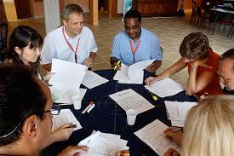
How to Exhibit a
Learners Attitude
GROUP ACTIVITY:
Break up in to 4 groups of 6 - 7 people
Decide on an example of “How to exhibit a learners attitude”.
Select a few members to tell a story of a situation that exhibits a learners attitude
You have 5 minutes
Present your story

Slide 8
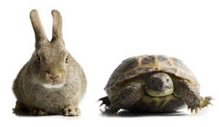
Foundational Attributes
100% Commitment
Jeremiah 29:13, “You will seek me and find me, when you seek me with all your heart.”
Matt. 22:36-38, “…love the Lord your God with all your heart.”
Luke 14:26-28, “…count the cost…”
Luke 14:33, “...any of you who does not give up everything he has cannot be my disciple.
Notes:
100% commitment sounds pretty bold. It sounds like too much. It is too much for many but to fulfill God’s call on your life, you have to be “all in” … 100%.
Before committing, you have to understand and count the cost. Counting the cost will help when times are tough. You won’t be surprised. You wont be disillusioned.
Jesus said we had to renounce all that we have. Compared to Christ, everything else has to be nothing.
If you have a 100% commitment then you will never sacrifice for God ... because the joy will overwhelm the feeling of sacrifice.
Paul was 100% COMMITTED -- 2 Cor 11:23 Are they servants of Christ? I am a better one—I am talking like a madman—with far greater labors, far more imprisonments, with countless beatings, and often near death.

Slide 9
Foundational Attributes
A Communist Looks at Christianity
From Paix Et Liberte – a French Communist Publication, 1950
“We Communists do not play with words. We are realists, and seeing that we are determined to achieve our object, we know how to obtain the means. Of our salaries and wages, we keep only what is strictly necessary; we give up the rest for propaganda purposes; to this propaganda, we also consecrate all our free time and part of our holidays.”
“You, however, give only a little time and hardly any money for the spreading of the Gospel of Christ. How can anyone believe in the supreme value of this Gospel if you do not practice it, if you do not practice it, and if you sacrifice neither time nor money for it?”
“Believe me, it is we who will win, for we believe in our Communist message, and we are willing to sacrifice everything, even our life in order that the social justice shall triumph. But you people are afraid to soil your hands!”
Notes:
See http://www.forerunner.com/forerunner/X0522_Battle_for_World_Dom.html For more on this Quote.
This is radical, scary but also motivating.
What do we give our time to? Our money? Our praise and attention?
Can you imagine what we could do for Christ if we were as committed as communist are to their cause?

Slide 10
Foundational Attributes
A successful leader is one who believes his message enough to give all - time, talent, money, and even his life!
“A man who hasn’t found something he is willing to die for is not fit to live.” Dr. Martin Luther King, Jr.
God is calling for a team of 100%’ers in a world of 50%’ers who will break the plain of mediocrity and change their world for God!
100% COMMITMENT TO THE CAUSE OF JESUS CHRIST AND HIS CHURCH!
Notes:
We are called to change the world as an instrument of Christ.
Christ came to show us the Kingdom, its power, and purpose. He also showed us the cost of discipleship and the reward of a changed world.
If adults will pay the price, then young people will see the example.

Slide 11
Break Time
Be back in
10 minutes!

Slide 12
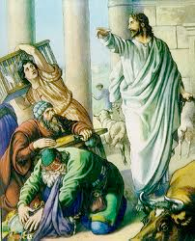
Functional Attributes
Submission to authority
Satan’s Original Sins
Ez 28:13-17 He Offended God’s Holiness - Matter of Conduct - Sin
Is 14:12-15 He Offended God’s Authority - Matter of Principle - Rebellion
Sinning(conduct) is easier to forgive than rebellion (principle)
Authority is absolutely necessary for effective leadership.
Matt. 7:28-29, “…the crowds were astonished… for he was teaching them as one who had authority.”
Notes:
Christ has all authority over heaven and earth. He laid that down when he came as a man, Jesus, and walked among us. He put himself under the authority of the Father. He modeled proper submission to authority (going to the Cross) and as such was given authority again
All authorities on earth are setup by God. Even authorities who seem to you evil or unfair. These authorities are delegated authorities from God and we are to obey them unless they command us to serve other Gods or do things contrary to Christian beliefs.
Until we follow well, we will not lead well.
Submit on the inside as well as on the outside.
2 Cor 13:10 For this reason I write these things while I am away from you, that when I come I may not have to be severe in my use of the authority that the Lord has given me for building up and not for tearing down.
------
Gossip is rebellion - Casual or unconstrained conversation or reports about other people, typically involving details that are not confirmed as being true.
Story about X12 Materials - Obedience can only go so far

Slide 13
Functional Attributes
Submission to authority
Submission to authority is a prerequisite to the obtaining of authority.
Matt. 8:8-9, “…I too am a man under authority, with soldiers under me.”
As we submit to God’s authority directly and indirectly (through delegated representatives), He will give authority to us!
Hebrews 13:17, “…obey your leaders and submit to their authority.”
Because the centurion was under the authority of another,
he was given his own authority!
Notes:
Christ has all authority over heaven and earth. He laid that down when he came as a man, Jesus, and walked among us. He put himself under the authority of the Father. He modeled proper submission to authority (going to the Cross) and as such was given authority again
All authorities on earth are setup by God. Even authorities who seem to you evil or unfair. These authorities are delegated authorities from God and we are to obey them unless they command us to serve other Gods or do things contrary to Christian beliefs.
Until we follow well, we will not lead well.
Submit on the inside as well as on the outside.
2 Cor 13:10 For this reason I write these things while I am away from you, that when I come I may not have to be severe in my use of the authority that the Lord has given me for building up and not for tearing down.
------
Gossip is rebellion - Casual or unconstrained conversation or reports about other people, typically involving details that are not confirmed as being true.
Story about X12 Materials - Obedience can only go so far

Slide 14
Gossip challenges Spiritual Authority
Gossip Skit --- Take 1
Gossip Skit --- Take 2
Notes:
Get 2 volunteers before the meeting and hand them the Gossip Skit
Take 1 - GOSSIP
Matilda - Did you see they way Pastor did that Altar call? uh uh uhm.
Bernie - Yeah, he was a bit too over the top with all that Hell, fire and brimstone stuff. Altar calls are about LOVE.
Matilda - Yeah, and, he waited f-o-r-e-v-e-r ! You know, I’ve got lunch plans after church.
Bernie - Last week we were so late to our lunch with family that all the rice gone. Can you imagine ... garlic chicken with NO RICE?
Matilda - Oh man, thats bad .. I think I’m gonna be like some of those other folks and “run for the door” when Pastor starts doing the altar call. At least we won’t go hungry
-------------------------------------------------------
Take 2 - NOT TO GOSSIP
Matilda - Did you see they way Pastor did that Altar call? uh uh uhm.
Bernie - Yeah, too bad no one raised their hand.
Matilda - Yeah, and, he waited f-o-r-e-v-e-r ! You know, I’ve got lunch plans after church.
Bernie - But Matilda, even if one had come forward, wouldn’t that have been worth the wait?
Matilda - Yeah, I guess so. But I don’t like all that waiting.
Bernie - You know Matilda, if you really have some input for Pastor on how he should do altar calls, you should go talk to him. Pastor will listen.

Slide 15
Functional Attributes
Submission to authority (Continued)
The results of submission to authority:
Luke 9:1-2, “He gave them power and authority… and sent them to preach the Kingdom and to heal the sick…”
Authority – Stamp of approval
Power – where-with-all to do it!
God
Family
Civic
Job
Church
Notes:
God delegates Authority and uses these authorities to give direction and protection
Submission to authority does produce results for God and you will see his Power and confidence by being obedient to him and his delegated authority
Be dead to yourself so that you can submit, don’t fight God’s discipline!! If you are dead to self then their is no fight.

Slide 16
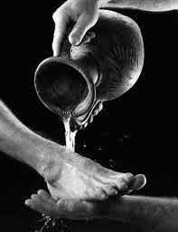
Functional Attributes
Servant’s heart
Luke 22:24-27, “I am among you as one who serves…”
Matt. 20:27, “Whoever will be greatest… be the servant.”
Philippians 2:3, “...count others more significant than yourselves.”
Don’t make it HARD for others to ask you to serve or to help out.
WHY DO THEY EVEN HAVE TO ASK YOU?
Notes:
You Know you are a servant when you are ok with being treated like one
A servants heart is an attitude of NOT being better than others. Being able to do things for others which may seem lowly. The thing that most don’t understand is that the higher your position, the more you serve. For instance, if you own a company and there is a budget shortfall, you pay your employees and you go without until things are corrected.
As a leader, you serve by shouldering others burdens with them. You hold them up in prayer. Look at Moses, he was the leader of all the Israelites but he worked tirelessly … he didn’t loaf around.
------
I know you serve in church ... How do you serve in the workplace? At School?
DON"T MAKE IT HARD FOR OTHERS TO ASK YOU TO SERVE

Slide 17
Functional Attributes
Humility/Dependence on God
Matt. 18:1-4, “whoever humbles himself… is the greatest.”
Hebrews 2:13, “…I will put my trust in Him.”
Zech. 4:6, “It’s not by might, nor by power, but by my Spirit.”
Humility before God and men!
Humility - Recognition that all I am, all I have, all I can do is a gift from God.
This leaves no room for pride and no room for self deprecation.
Notes:
Like a servants heart, humility and brokenness require putting others first. If you exalt others, God will exalt you.
Just say “Thank you” when receiving a complement. Don’t argue with them, saying “no, no, no ... I’m just ...” this self deprecation is just asking the person to say it again.

Slide 18
What is a Growth Group?
New Hope Town believes spiritual growth flows out of a commitment to significant Christian relationships. To help develop these significant relationships, we are offering “Growth Groups.”
New Hope Town Applicable Core Values are:
Core Value #4 – We Believe that every member is a “minister” who is to be equipped and released according to their God given gifts to meet the needs of the people of our community and New Hope Town Ohana. Core Value #9 – We believe that emotional health is a vital and necessary pursuit in becoming free and fruitful followers of Christ.
It is our goal to have every member of New Hope Town involved in either a Growth Group or another similar small group experience. While most groups are sermon-based, some are special interest groups focusing on topics such as emotionally healthy spirituality, parenting, marriage recovery and Christian basics for new believers.

Slide 19
What is a Growth Group?
What is a Growth Group? Growth Groups meet throughout the island one night a week on the first three weeks of the month. The 4th and 5th weeks are to be a time for family events, outreach or meeting with other growth groups. Most groups meet on Sunday or Wednesday nights but each group may have a different meeting time.
A Growth Group is a home fellowship made up of 10-16 people who meet to share, study and support one another. A trained leader and host lead each group. An average meeting lasts for an hour and a half, followed by light refreshments.
What Will We Study? Most of the studies are based on the previous weekend’s message. These “sermon-based” Growth Groups are built on what we call a “Lecture-Lab” model. Imagine the weekend message as a lecture on Christian living, and the Growth Group as a lab where you get to roll up your sleeves and discuss how the weekend’s message works in real life.

Slide 20
Questions?

Slide 21
Action List (Prep for Next Week)
Have Devotions & Prayer Daily
Read “How to Win Friends and Influence People” by Dale Carnegie.
Listen to ”How To Lead”, “How to Motivate” and “Characteristics of a Leader” by Howard Hendricks.
Write down the following attributes of the Growth Group or Ministry you want to start after LTS:
Target Audience (Young Adult Men, Married Couples, etc.)
Ideal night of week, meeting time, and start date
Complete the Online Discussion Questions
Notes:
It is very important that you complete the items in the ACTION LIST. If you fall behind, it will be hard to catch-up.

Slide 22
Conclude
Assign Refreshments
Close with prayer.

